Slide 1
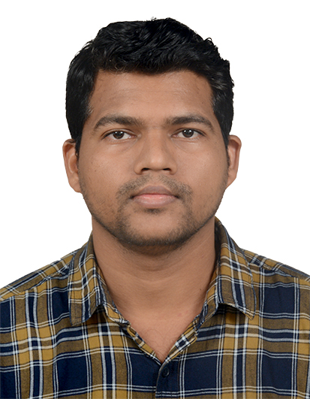
Kiran Sayalekar
8+ years of experience in Java (Spring/Spring-Boot/Hibernate/JPA) Development. Highly analytical, Self-motivated Senior Associate with ability to understand and build complex systems using innovative technical solutions. Involved in Development, delivery, Data migration, security implementation, migration & adoption. Focuses relentlessly on removing impediments and delivering customer-centric products and features using Agile.
CONTACT
Experience Summary
Phone No: +91-7798779881
Email Id: kiranprakash.sayalekar@cognizant.com
Location: Pune, MH
Lexicon Network India Pvt ltd– Solar Smart Suit
Year 2019 - 2023
Team Lead - Database Design, Development & Maintenance
Designed a project with multi maven module base architecture with Spring boot, JPA and MySQL as a database.
Configured the backend application with Swagger, SonarQube, FTP, Email.
REST API implementation with Spring security like JWT token generation with encrypted and decrypted data.
Involved in all Agile ceremonies and design functional document for development purpose.
Designed a database and implemented store-procedure and functions.
Mentored junior developers in best practices for development
Gerrit was used for project code tracking by creating branch Development, Test and Production.
Used Jenkin for Internal deployment
Security configuration changes were done for server level.
EDUCATION
Sandip Institute of Technology and Research Centre, Nashik, MH 2010 – 2013
CERTIFICATION
OCP(Oracle Certified Professional) Java SE 6 Programmer
Lexicon Network India Pvt ltd– WiproOnTheGo
Year 2018 – 2019
TECHNICAL SKILLS
Sr. Developer – Database Design, Solutioning and Delivery
Java/J2EE, Spring, Spring Boot, Hibernate
Knowledge of Microservice, Kafka, Docker, Kubernetes
Databases –Oracle,, MySQL, SQL Server,
Agile – Scrum
ZOHO
User stories, TDD,
CICD Tools – Jenkins.
Developed a project with Spring framework, Hibernate and MySQL as a database.
Integrating SAP with Java project with sapjco libraries and implemented multiple functionalities using REST API’s.
Modified existing database and implemented store-procedure for report generation.
Migrated the application from Cordys to Java and implemented cron job scheduler to fetch records from SAP.
Provided the required changes at tomcat level for application security like Https, default port changes and to prevent like vulnerabilities attack like click jacking
Lexicon Network India Pvt ltd– Forbes-Marshall
Year 2016 – 2018
Sr. Developer – Database Design, Solutioning and Delivery
Application developed with Spring framework, Hibernate and Oracle as a database configuration.
Implement REST API to generate report for end user base on provided format in Excel and PDF files.
Implemented store-procedure for report generation.
Involved in requirement discussion with client
Gerrit, Jenkin was used for development server deployment and production deployment was done by accessing WinSCP and putty.
OTHER SKILLS
Problem solving, Leadership, Team player, Time management, Critical Thinking, Communication and Interpersonal skills.
AWARDS
Best Performer, 2020

